Slide 1


FOOD HUB
by
Aditya Kamat CSE/092/21
Janmenjay Mahato CSE/093/21
Sahil Kumar Patro CSE/094/21
Kamran Khalid CSE/095/21
Under the guidance of
Prof. Smita Dash
Dept. of Computer Science and Engineering
DEPARTMENT OF COMPUTER SCIENCE AND ENGINEERING
R.V.S COLLEGE OF ENGINEERING AND TECHNOLOGY,
JAMSHEDPUR

Slide 2

INTRODUCTION
Online Food ordering system is a process in which one can order various foods and beverages from some local restaurant and hotels through the use of internet, just by sitting at home or any place. And the order is delivered to the told location.
The Online Food Order System in PHP is a simple project developed using PHP, JavaScript, and CSS. The project connects different restaurants with customers. The project contains an admin(manager) and the user side. All the management like editing site contents, updating food items, adding restaurants, and checking order status can be managed from the admin side. There can be many managers on the site.
For the user section, the users can go through the homepage, about, and contact pages. In order to order the food items, the user has to create an account and sign in or log in. The food comes with the cost as well. This project makes a convenient way for customers to buy/purchase food online, without having to go to the restaurant.
This Online Food Order System is in PHP, JavaScript, and CSS. Talking about the features of this system, it contains the admin(manager) section and the user (customer) section. All the editings , updating, managing order details, food items, and restaurants are from the admin section while customers can only go through the site and give orders if want. The design of this system is simple so that the user won’t get any difficulties while working on it.

Slide 3
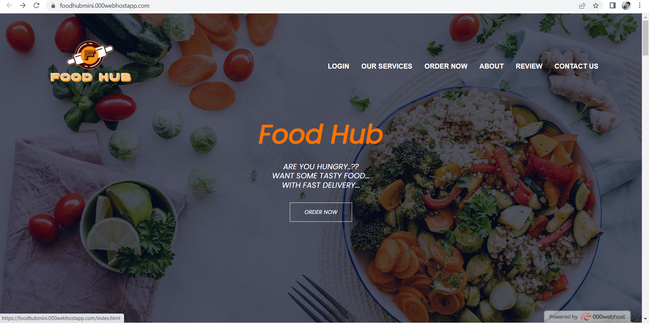
HOW FOOD HUB WORKS?
THIS IS THE HOME PAGE

Slide 4
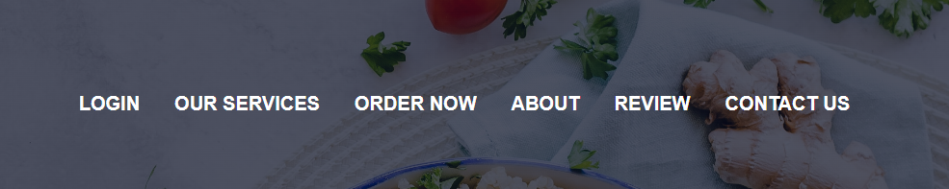
HOME PAGE
Home page basically gives you six different operations to perform.
LOGIN: By clicking on this option you can create you account or login to an existing account.
OUR SERVICES: Here you can know about the services that we provide to our customers.
ORDER NOW: This option will take you to the list of foods available on the platform.
ABOUT: This section tells you about some basic information about the website.
REVIEW: You can check out the reviews given by the customers.
CONTACT US: If you have any queries, you can click on this option to connect with us and get your answers.

Slide 5
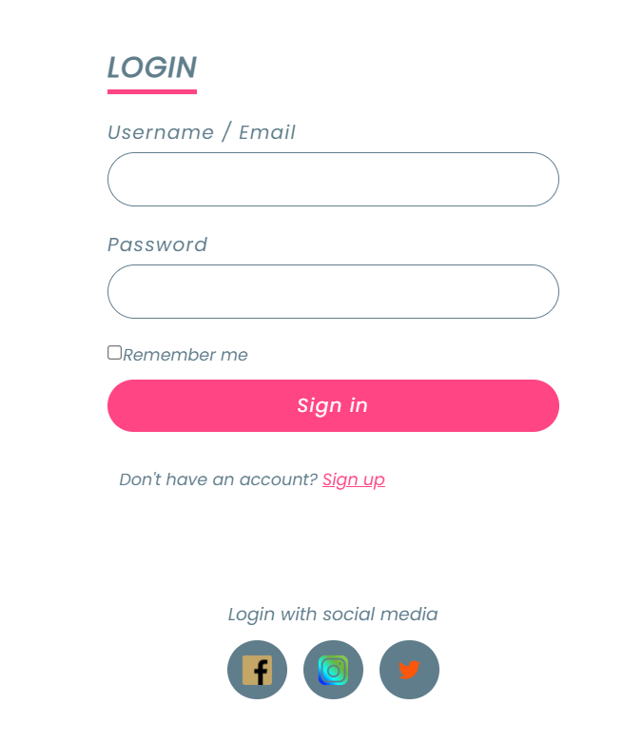
LOGIN PAGE
Here you can enter you username or email id.
Here you can enter your password.
After entering your details, you can click on ‘sign in’ to proceed.
But, if you don’t have an account on our website , you can click on ‘sign up’ option to create an account.

Slide 6
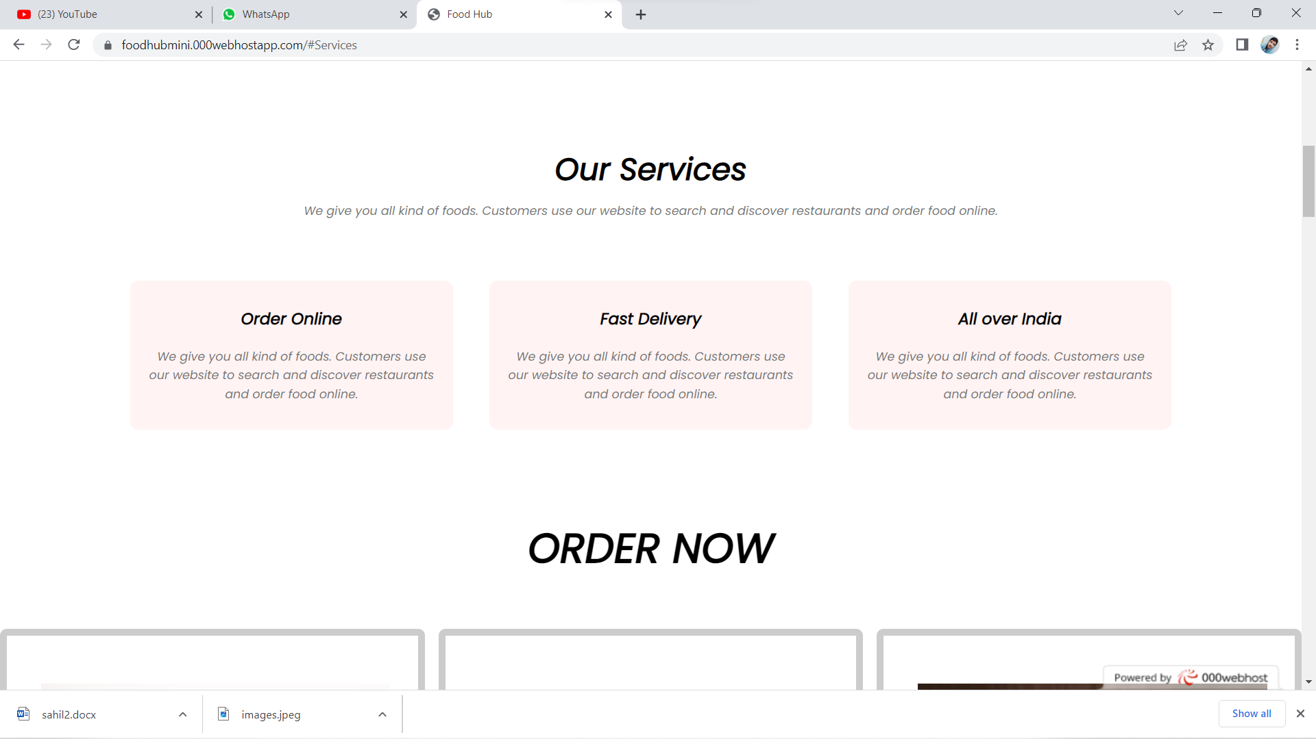
OUR SERVICES

Slide 7
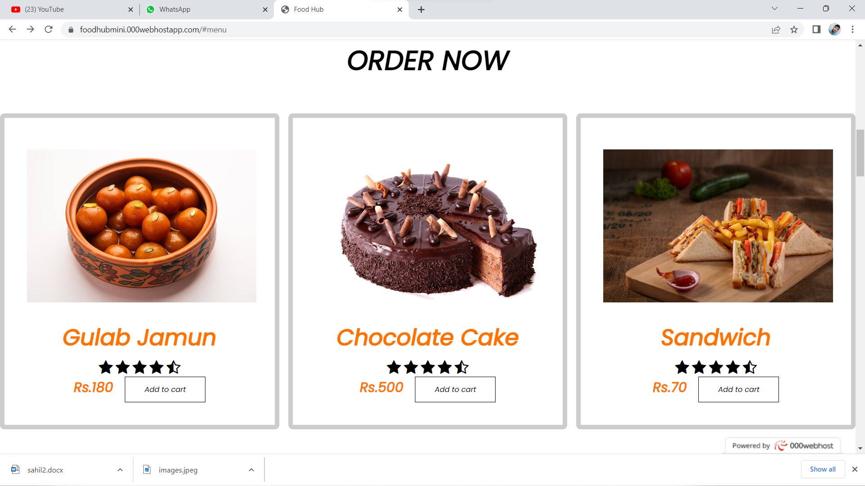
ORDER NOW PAGE
THIS THE PART OF THE WEBSITE ,WHERE YOU CAN ORDER YOU FOOD.

Slide 8
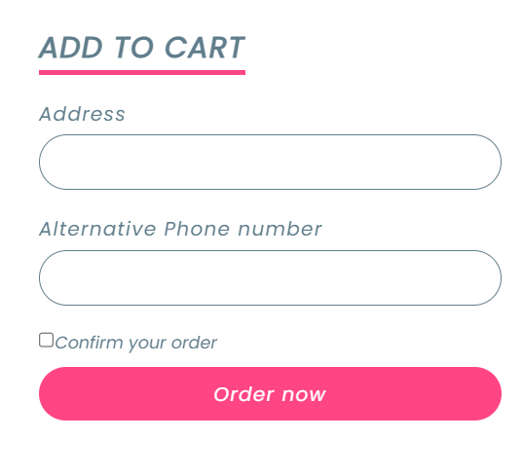
STEPS TO ORDER FOOD
STEP 1: Click on the ADD TO CART option.
STEP 2: enter you address and phone number.
STEP 3: click on ORDER NOW.

Slide 9
CONCLUSION
An online food ordering system is developed where the customers can make an order for the food and avoid the hassles of waiting for the order to be taken by the waiter. Using the application, the end users register online, read the E-menu card and select the food from the e-menu card to order food online. Once the customer selects the required food item the chef will be able to see the results on the screen and start processing the food. This application nullifies the need of a waiter or reduces the workload of the waiter. The advantage is that in a crowded restaurant there will be chances that the waiters are overloaded with orders and they are unable to meet the requirements of the customer in a satisfactory manner. Therefore by using this website, the users can directly place the order for food to the chef online.

Slide 10
REFERENCES
W3 html, css, js tutorials(https://www.w3schools.com)
Learning web design, Book by : J.N Robbins, Published by: O’Reilly
Web design tutorials on youtube by CodeWithHarry (http://www.youtube.com/playlist?list=PLu0w_9III9agiCUZYRsvtGTXdxkzpyltg)
https://youtu.be/8KVrdL0VcAk
https://projectworlds.in/free-projects/php-projects/food-ordering-system-project-in-php/

Slide 11
THANK YOU

